Slide 1


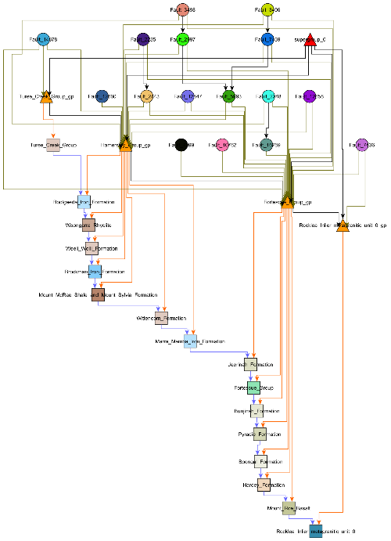
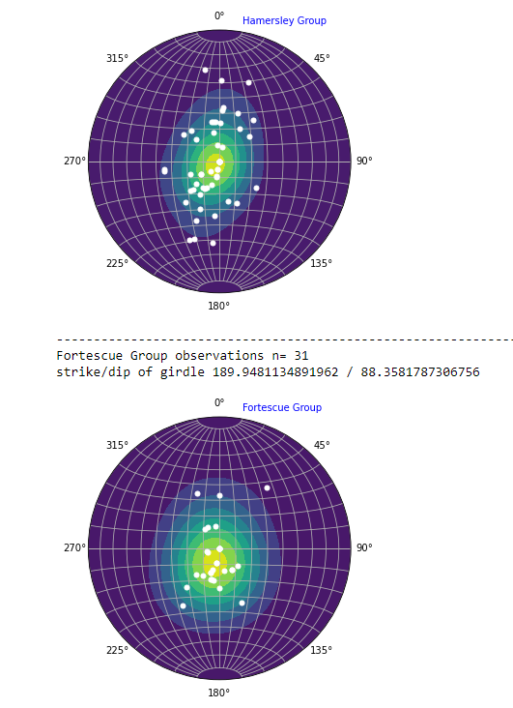
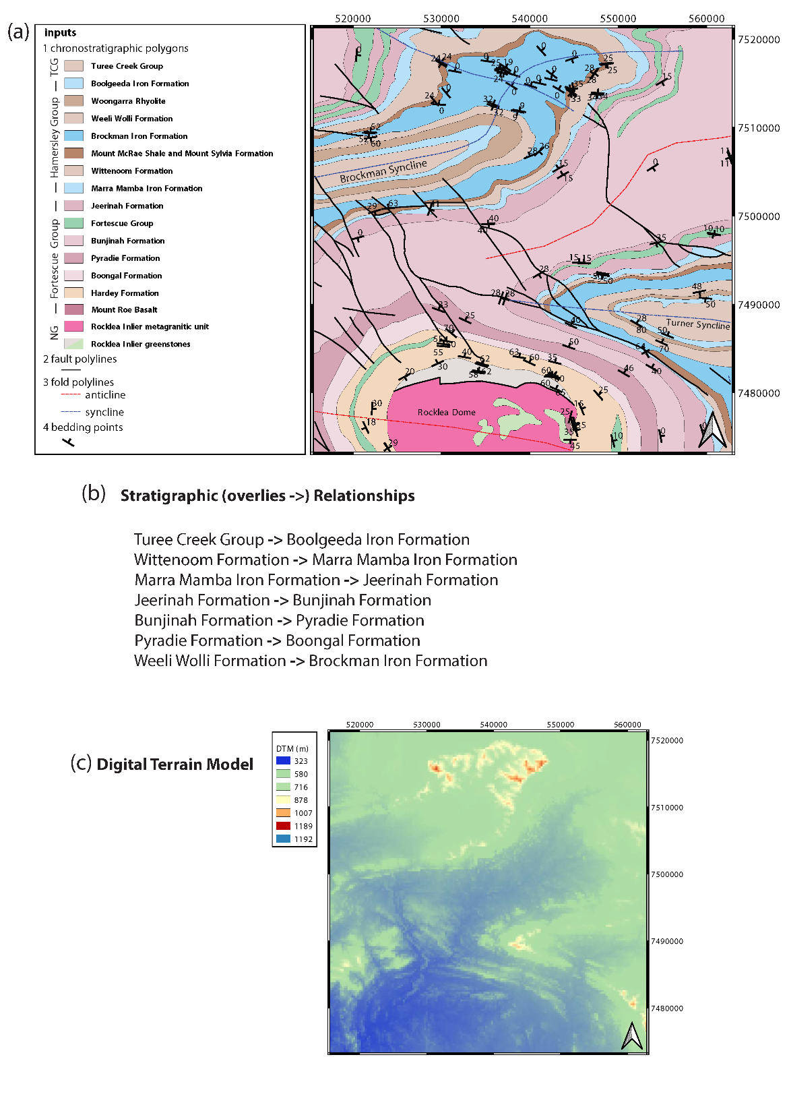






WP2: Map deconstruction aids 3D model construction
Mark Jessell, Vitaliy Ogarko, Mark Lindsay, Ranee Joshi, Lachlan Grose, Laurent Ailleres, Michel Nzikou, Guillaume Pirot
Busselton March 2020

Slide 2
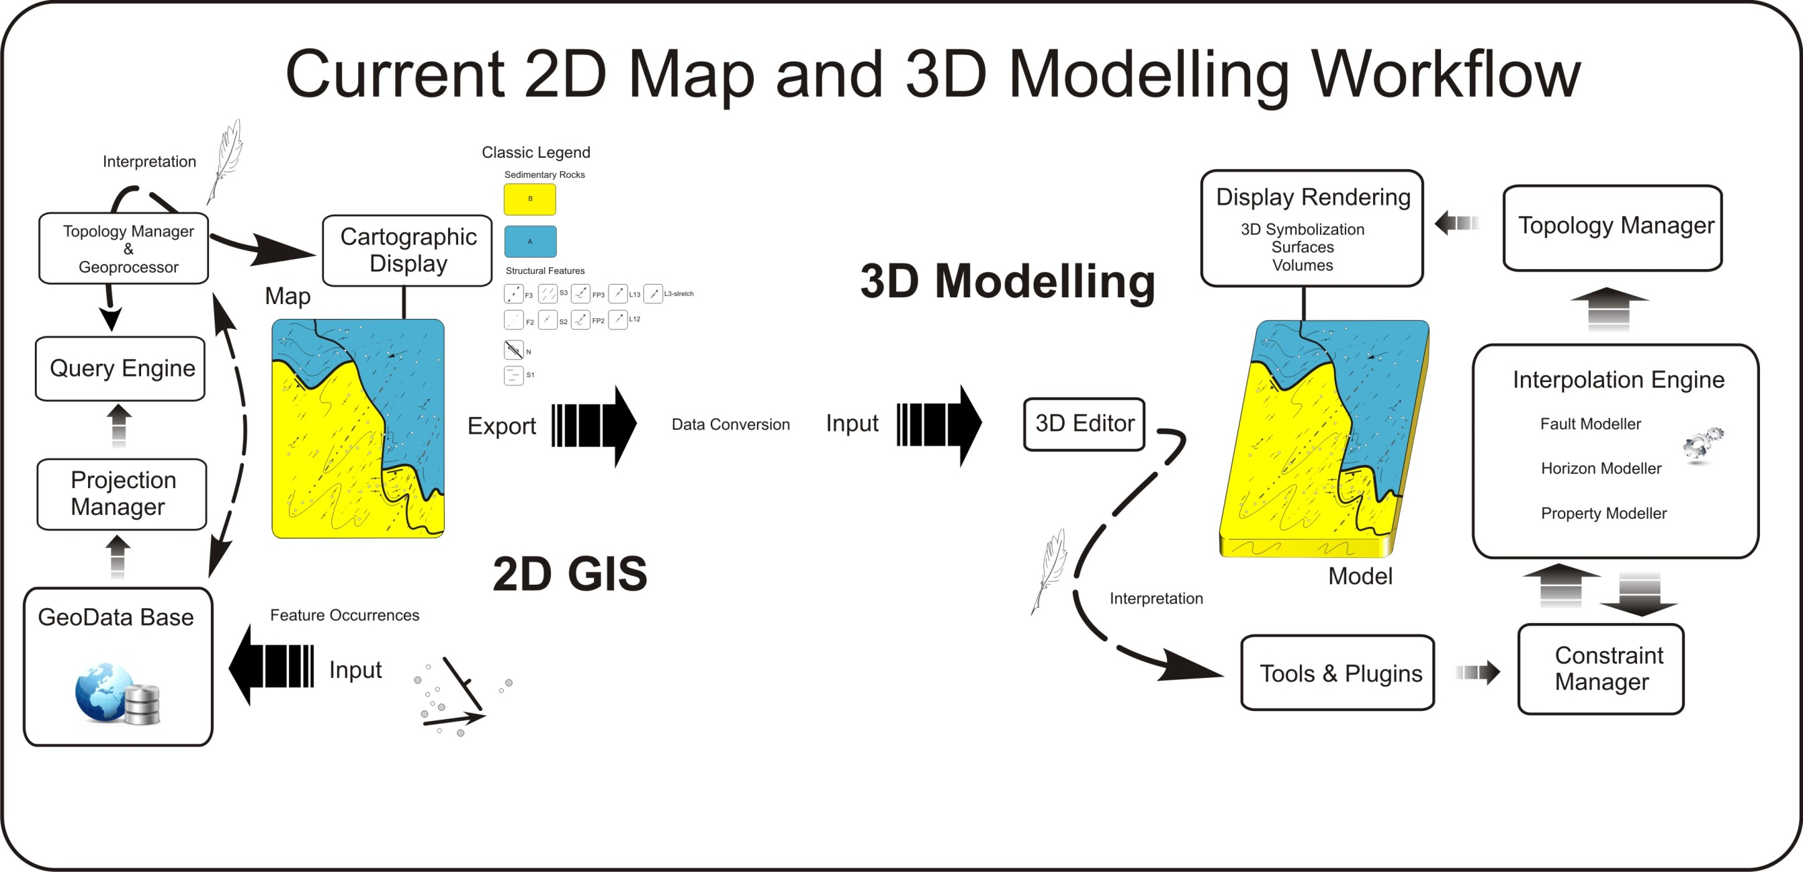
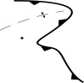
One-way one-model !
WP2
EDK
WP2 will provide Loop with the ability to directly access online and offline geoscientific datasets, which it will then process to extract the data required for 3D Geological Modelling. This includes re-projection, upscaling, information extraction and exporting in native formats aimed at a variety of implicit 3D Geological modelling engines.
Notes:
How do we currently make our 3D models, a quick generalization is worth reflecting on. In the end we follow a linear workflow. Models are rarely used to update a primary data store with new relationship or insight. All new knowledge is embedded in the model.

Slide 3
Why map2loop?
Significantly reduces the time to first prototype models;
Allows reproducible modelling from raw data, whereas current Uncertainty Quantification workflows start from model-ready inputs;
Clearly separates the primary observations, interpretations, derived data and conceptual priors during the data reduction steps; and
Provides a homogenous pathway to Sensitivity Analysis, Uncertainty Quantification, Multiscale Modelling and Value of Information studies

Slide 4
Principles:
Accept structured data as-is
allows real-time modelling
Modify on the fly
reproject, upscale, derive missing information, define conceptual constraints
Iteratively define all parameters needed to build a model so that they can be front-loaded into map2loop
ensures reproducibility

Slide 5
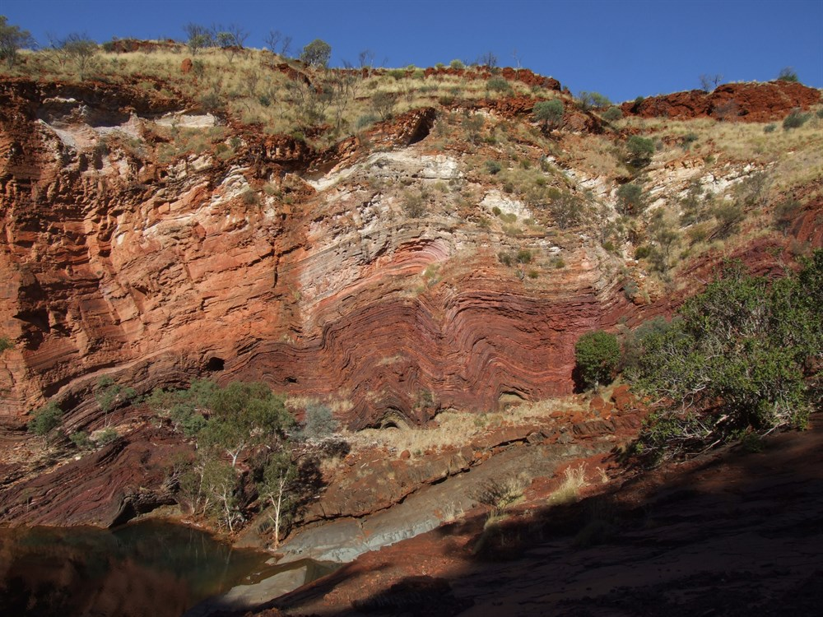
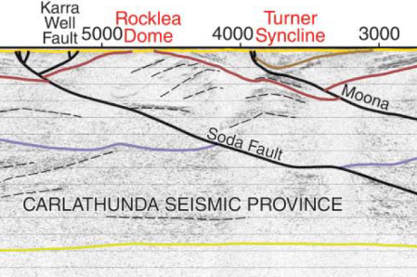
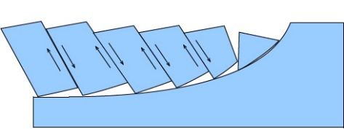
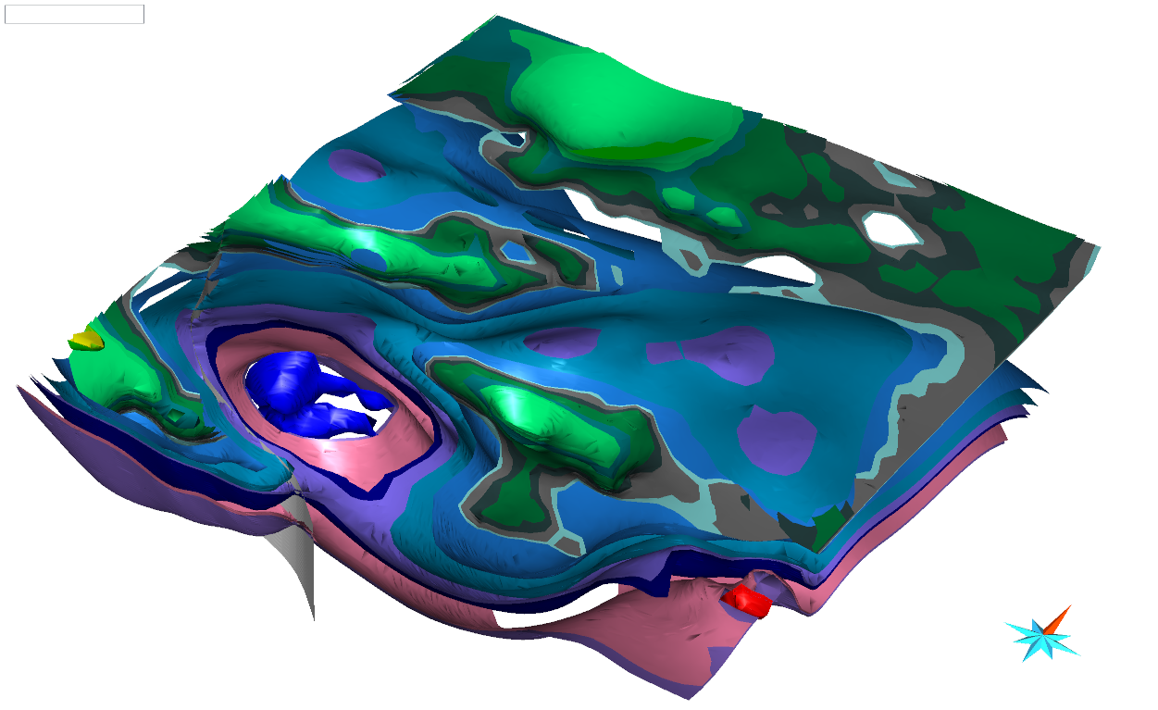
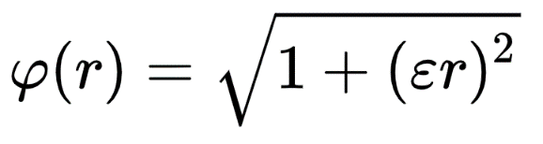
Ingredients of a 3D geological model (and sources of uncertainty)
Observations
Interpretations
Concepts
Algorithms

Slide 6

Current 3D Modelling Workflow
Observations
Concepts
Interpretations
Algorithms

Slide 7
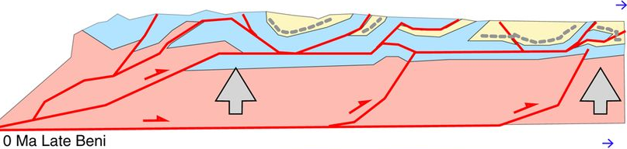
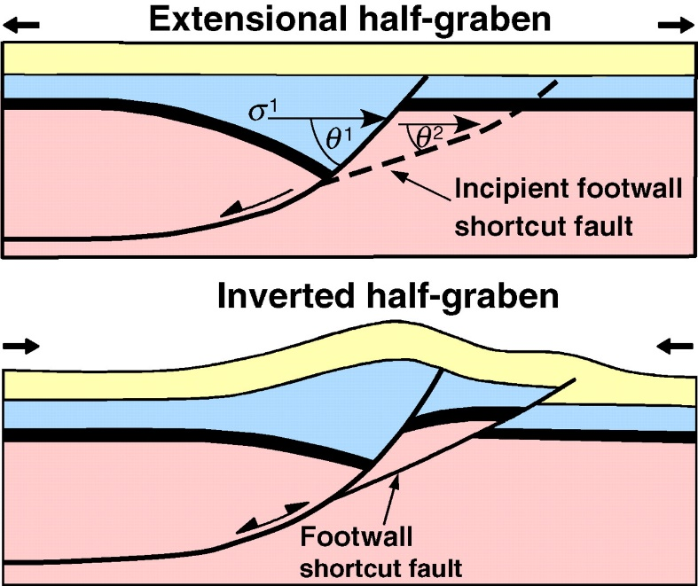

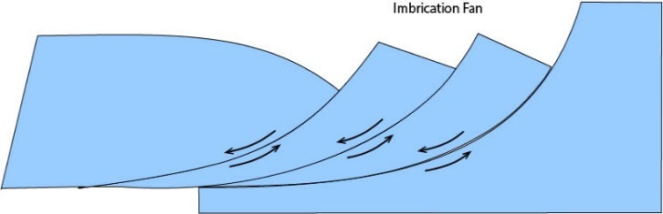
Prior concepts about region (faults)
Without limited geophysical constraints, the sub-surface geometry of faults is often ‘solved’ by applying a pre-conceived notion based on vertical, listric, flower or negative flow, fold & thrust geometries.

Slide 8
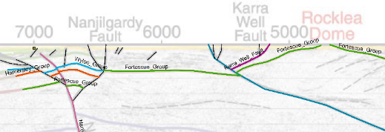
Prior concepts about region (faults)

Slide 9
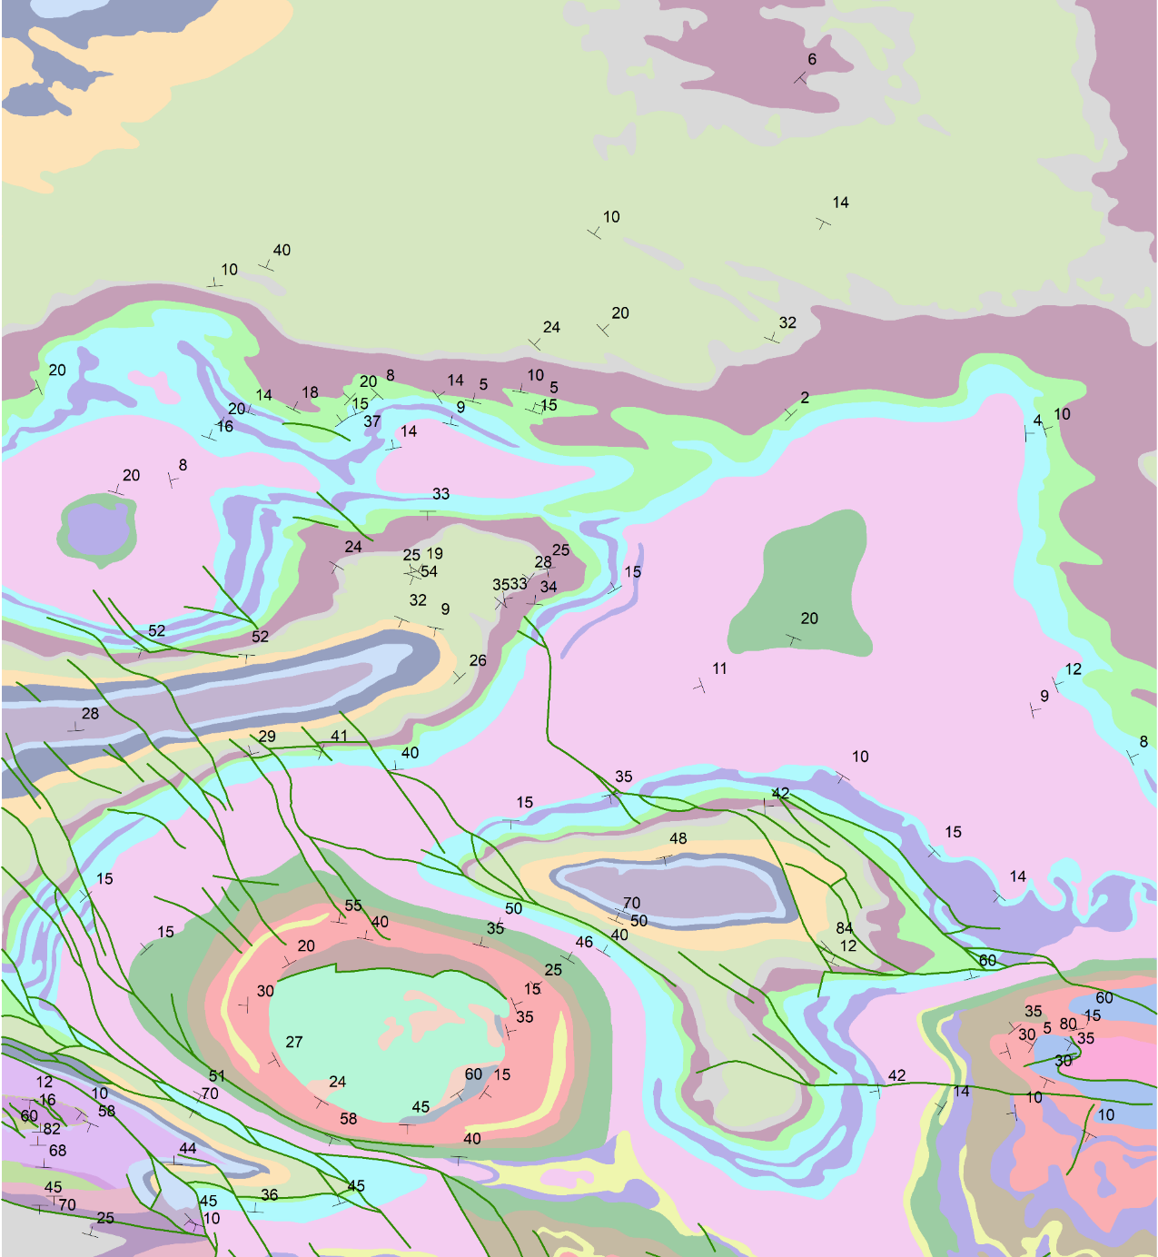
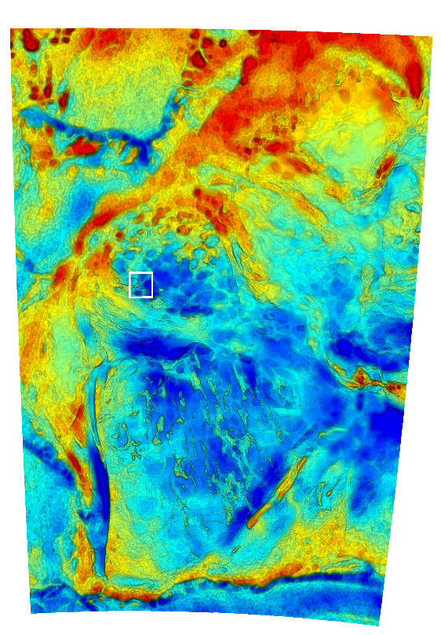
Two end-member regional 3D modelling scenarios:
Geological constraints come FIRST
GSWA 500K
Interpreted Bedrock Geology
1 degree square

Slide 10
Two end-member regional 3D modelling scenarios:
Geological constraints come FIRST
Under cover, so geophysics is FIRST constraint
Qs
GSWA 500K IBG

Slide 11
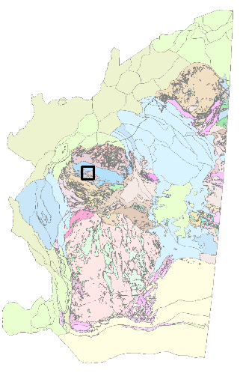
Loop Information Manager
map2loop
3 layers available via WFS
at geo.loop-gis.org/geoserver
Geology polygons (GSWA 500k IGB)
Fault polylines (surface trace, state)
Structural points (bedding, local area)
DTM online from GA

Slide 12
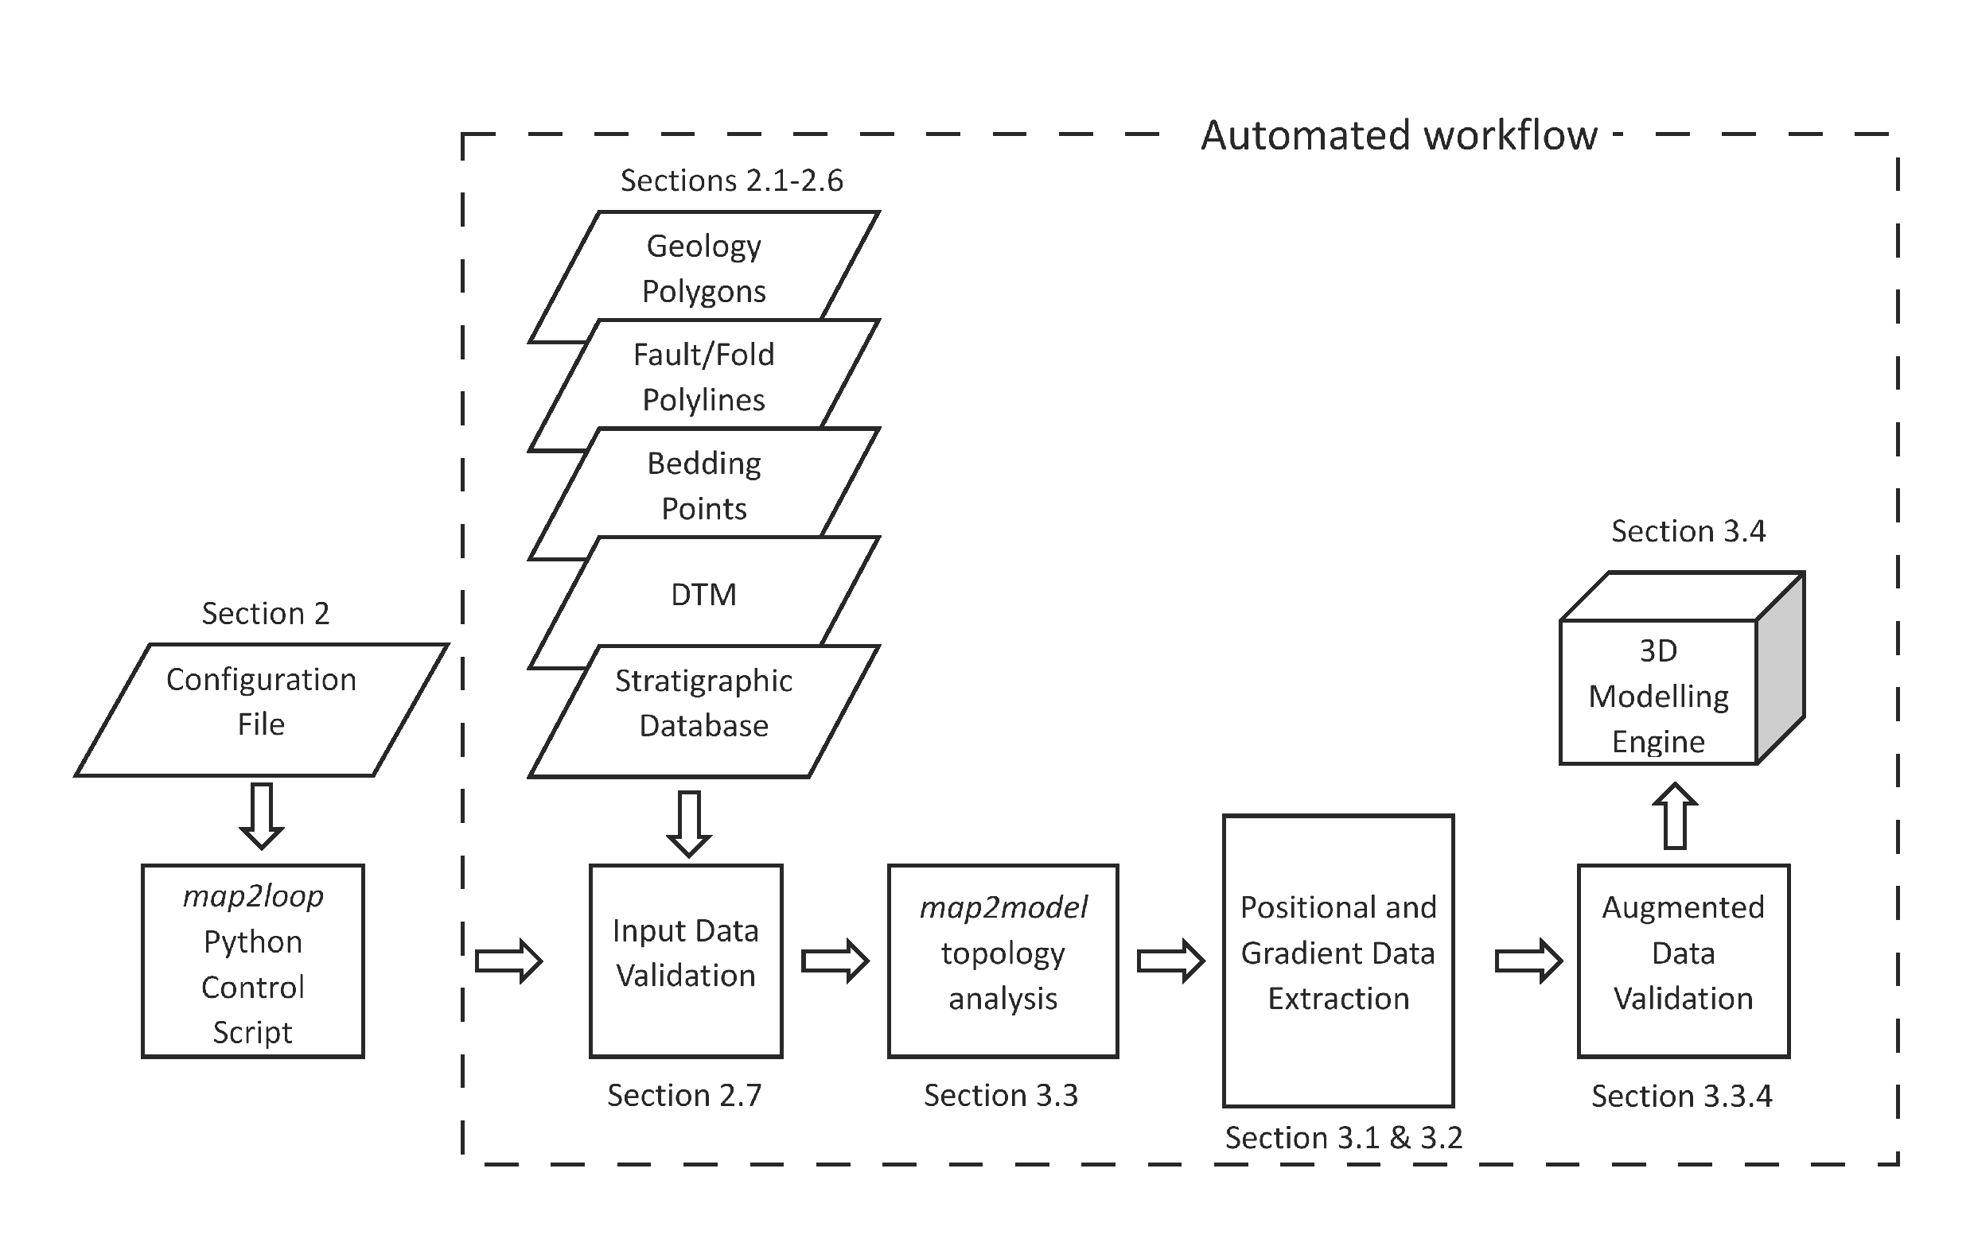

Slide 13
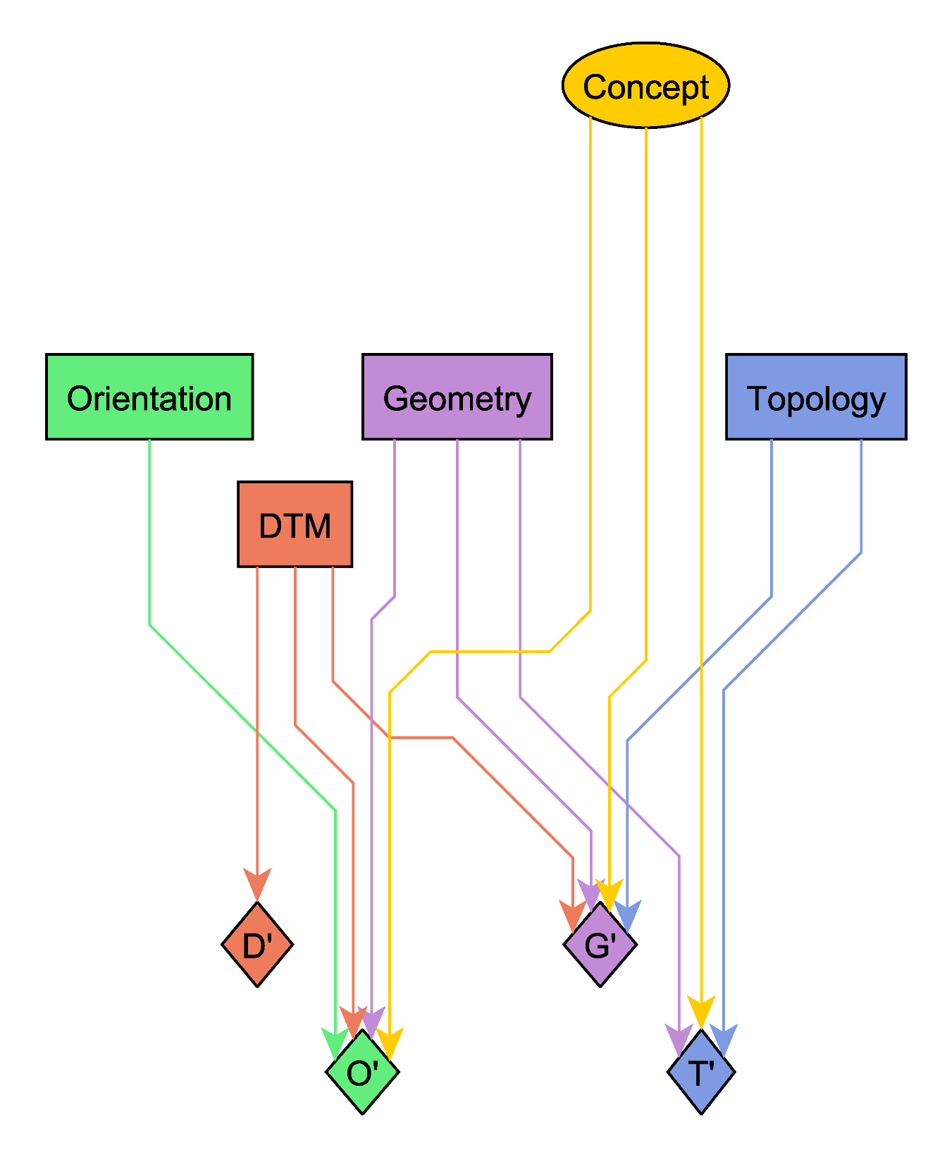
Concepts:
What is the geological framework in this region?
Observations:
Gradient
Position
Topology
DTM
Outputs:
Selected Observations
Subsampled Observations
Derived measurements
Gradient
Position
D’
P’
G’
T’

Slide 14
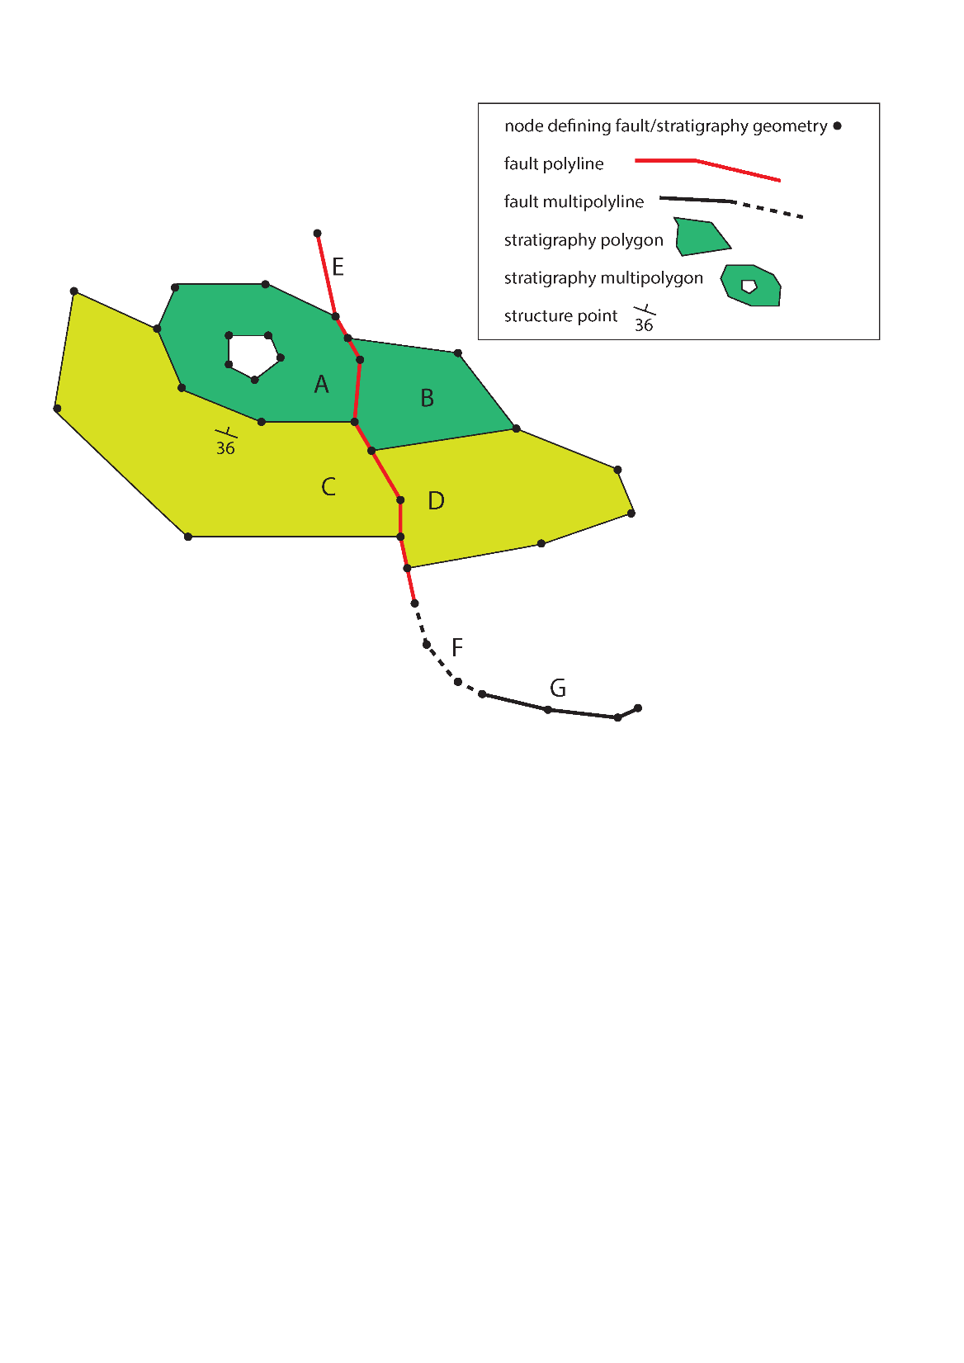
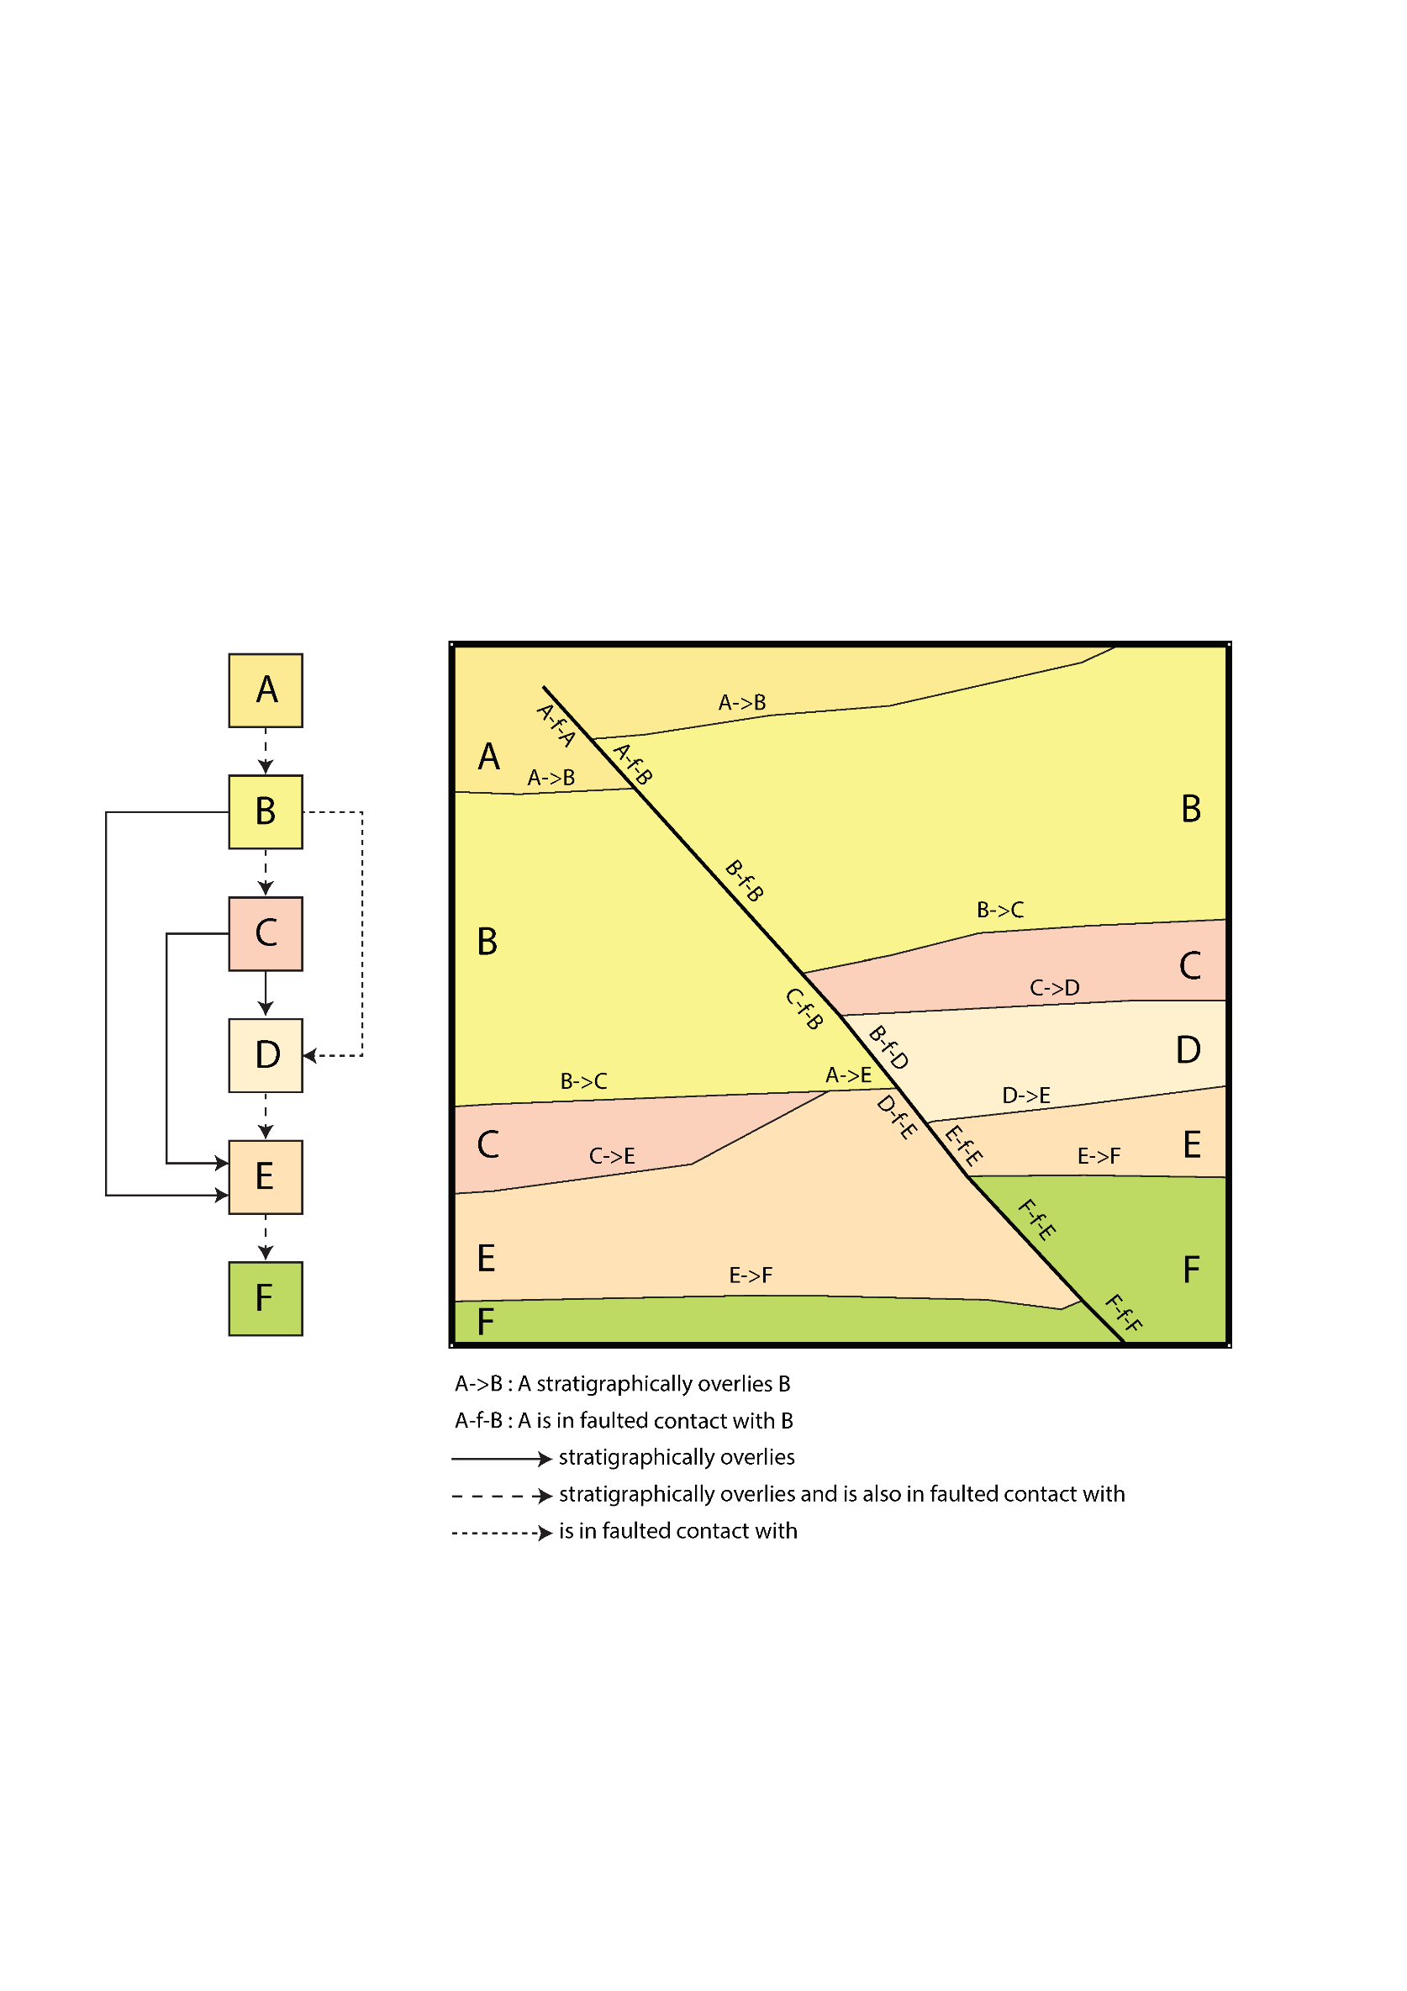
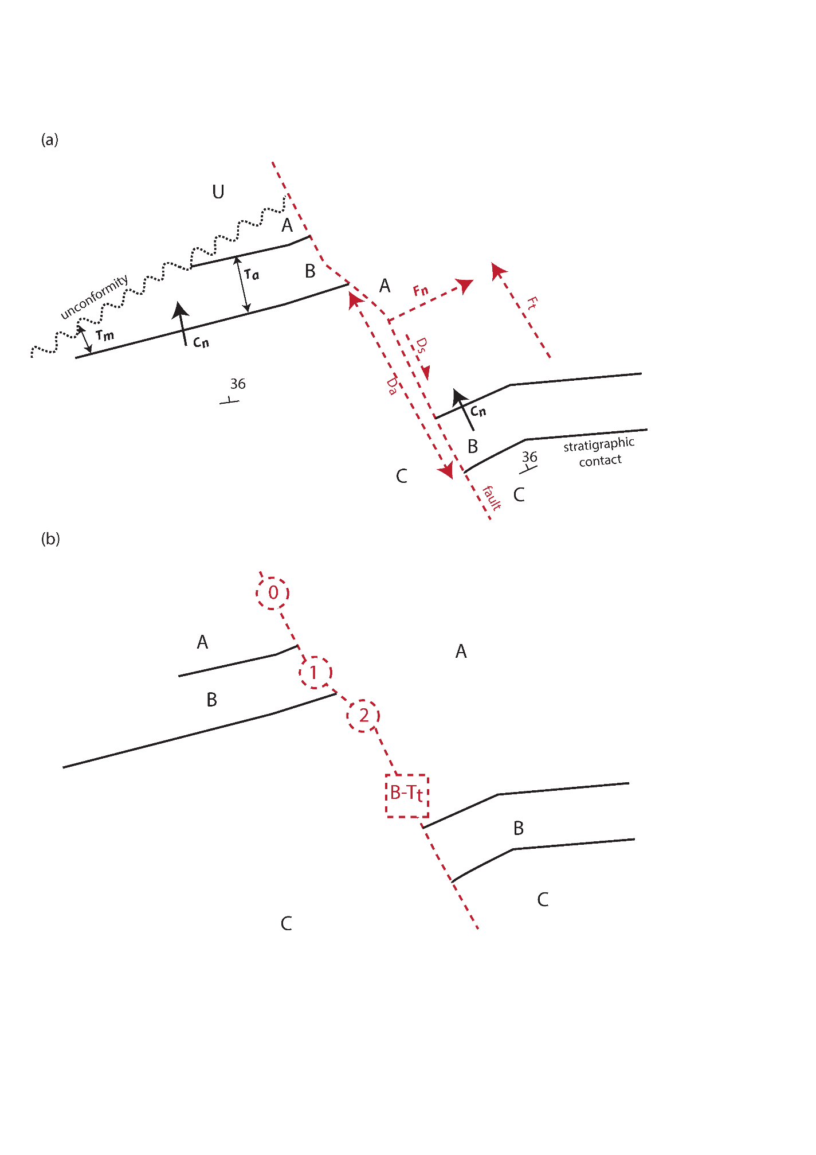
DTM RASTER
Fault displacement & formation thickness estimates

Slide 15
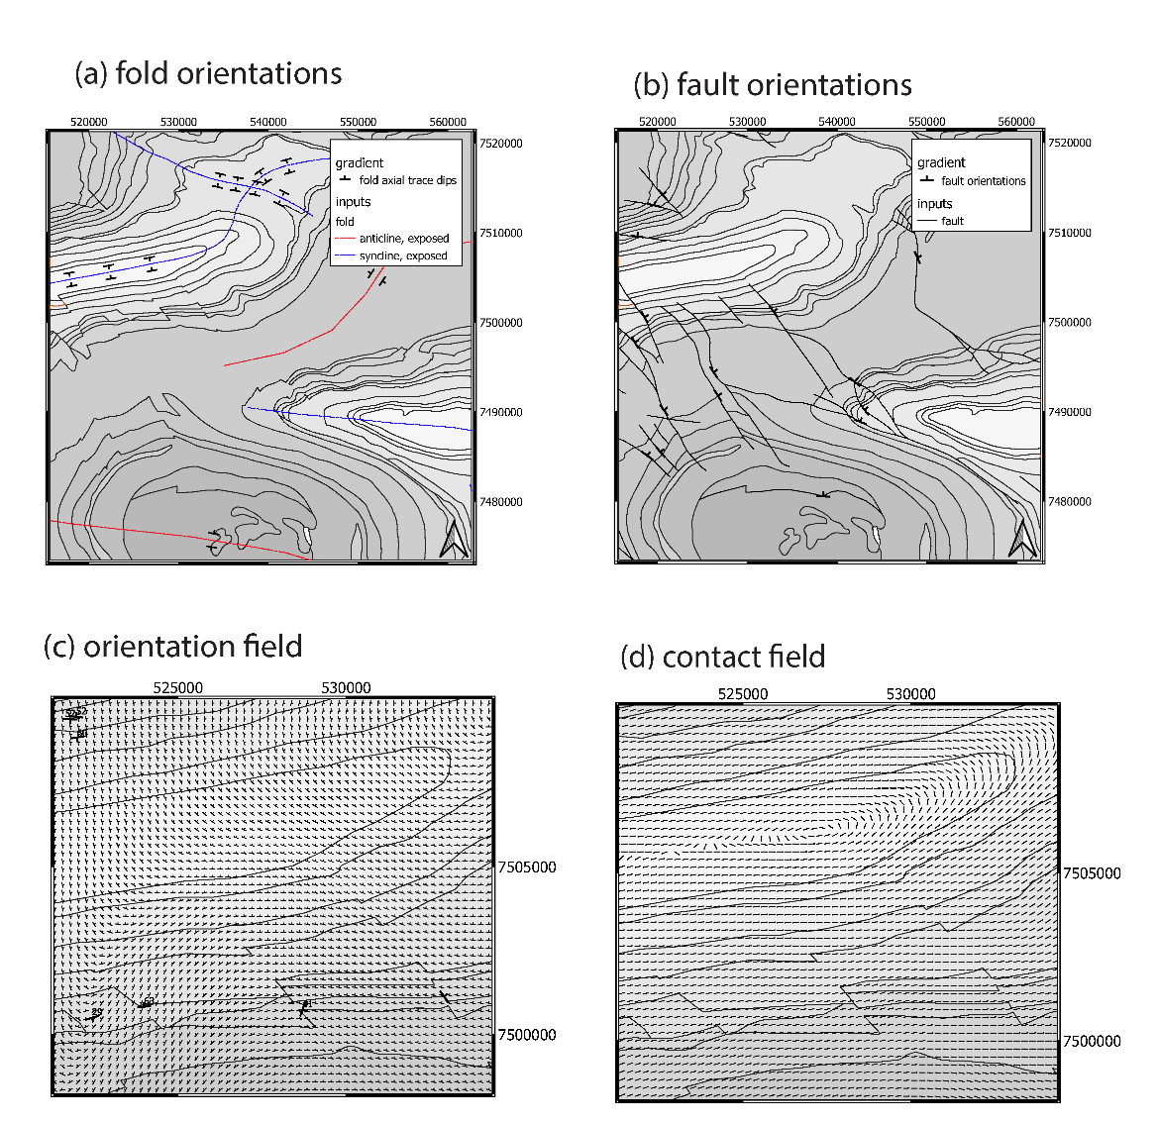
Outputs as series of cvs files & single LoopProjectFile

Slide 16
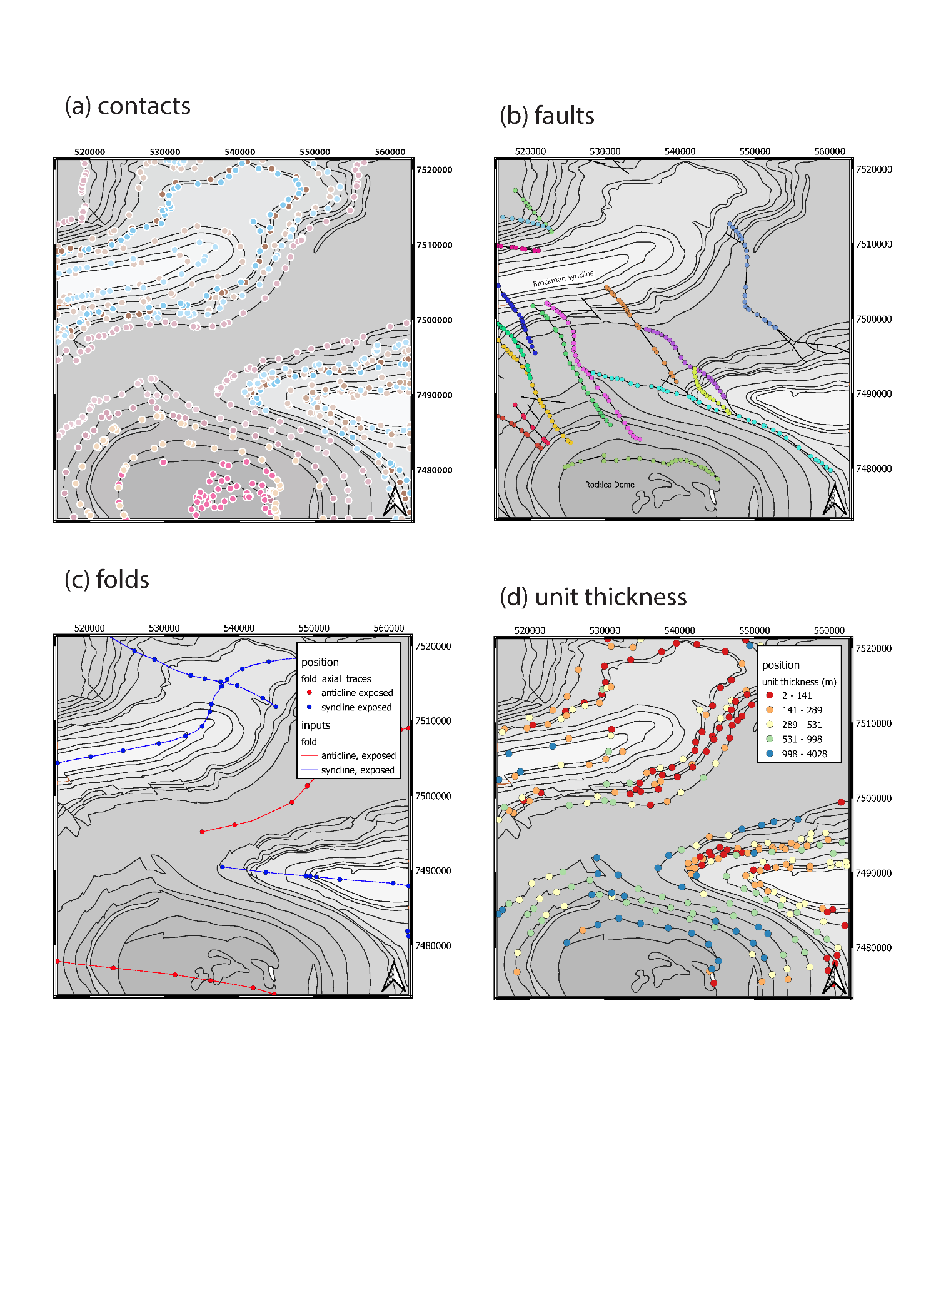
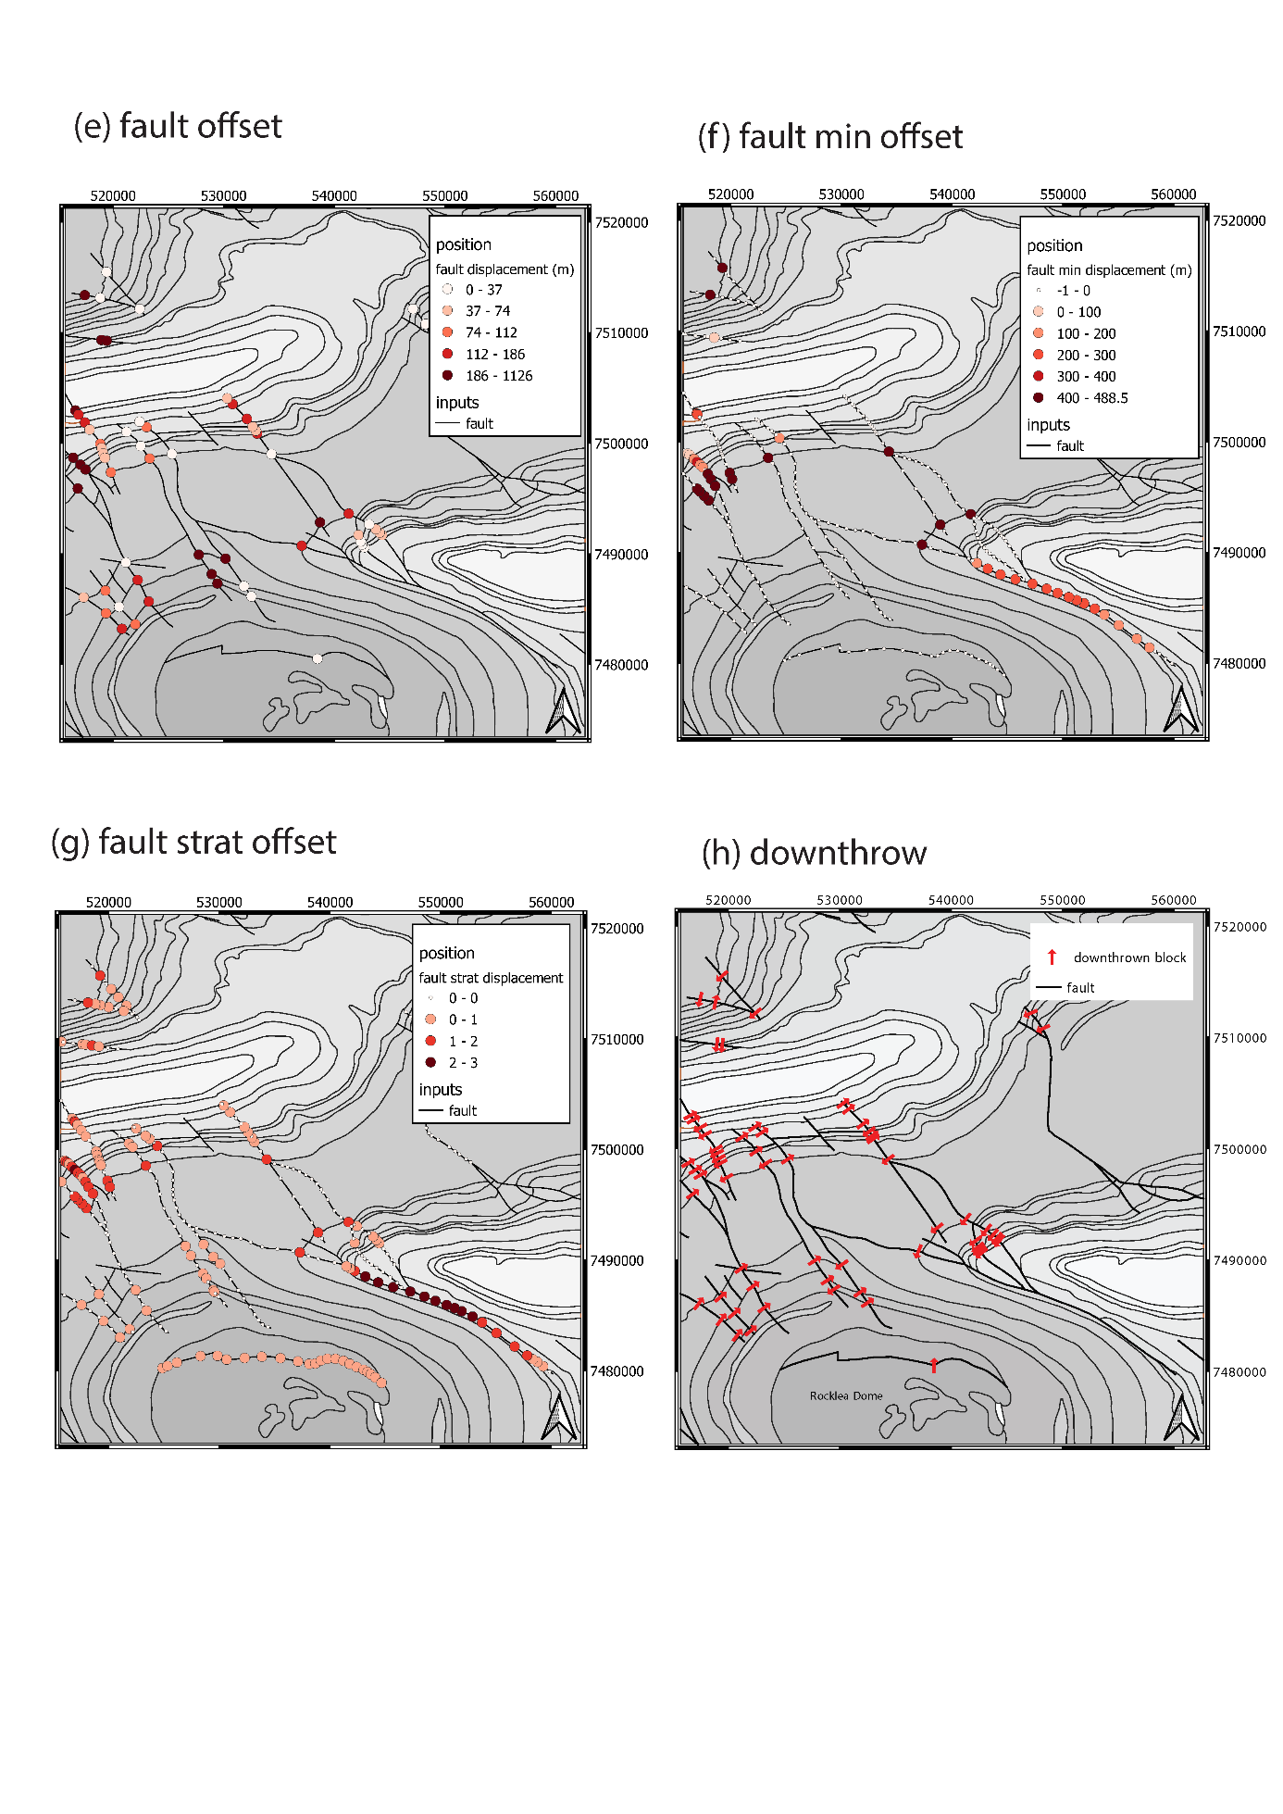

Slide 17
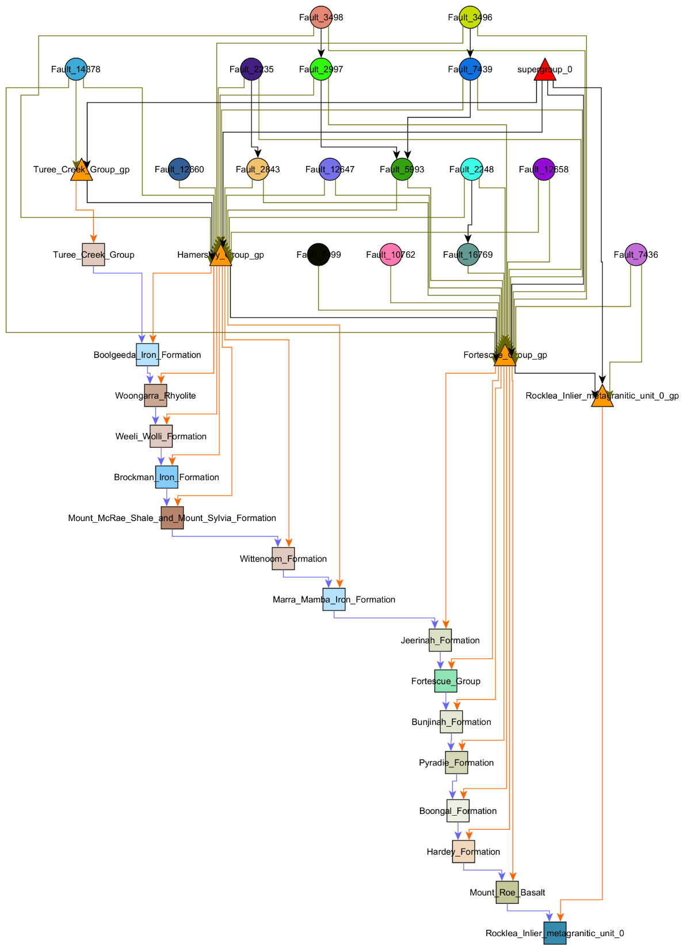
Faults
Young
Groups
Old
Formations

Slide 18
DTM RASTER
Fault displacement & formation thickness estimates

Slide 19
Outputs as series of cvs files & single LoopProjectFile

Slide 21
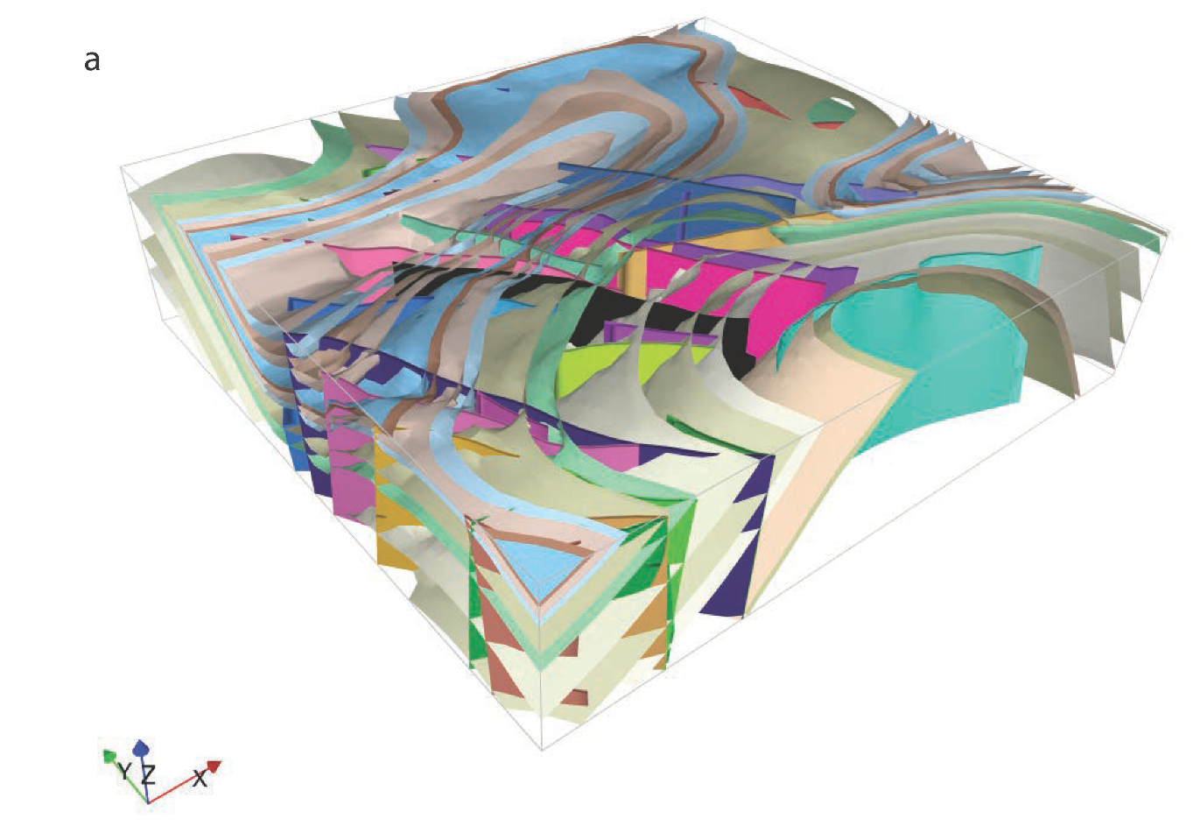

Slide 22
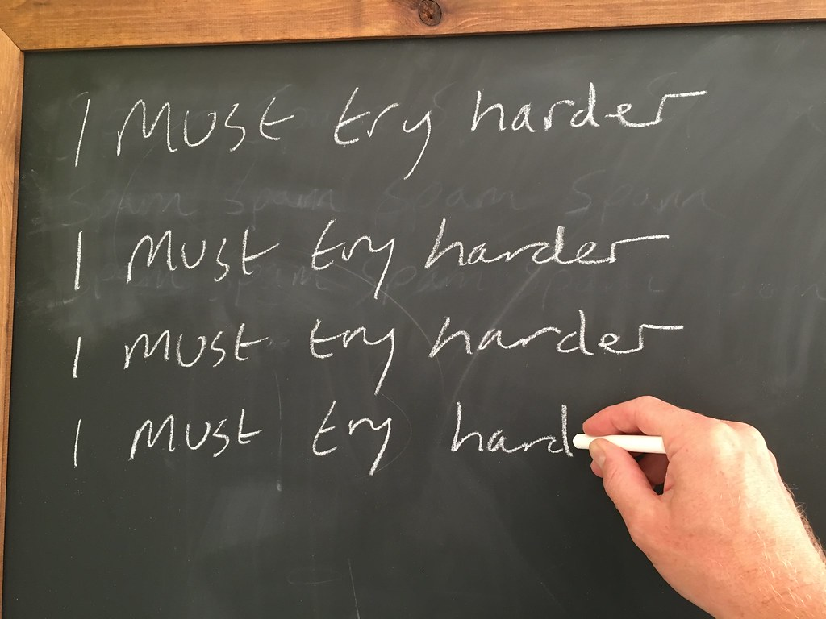
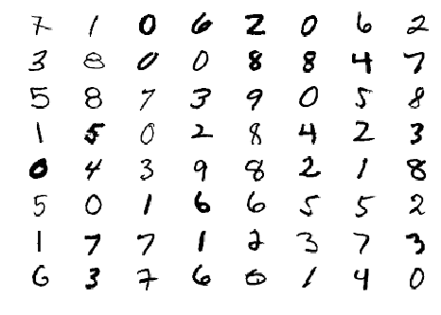
Weaknesses of maploop

Slide 23
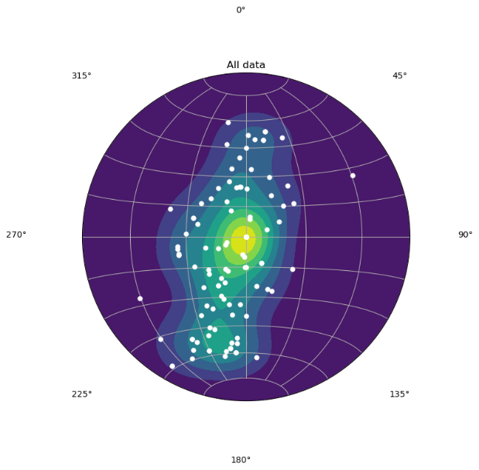
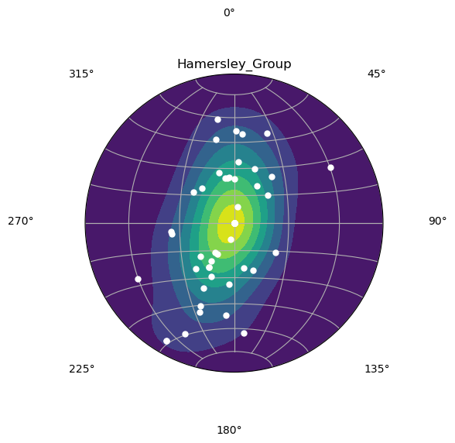
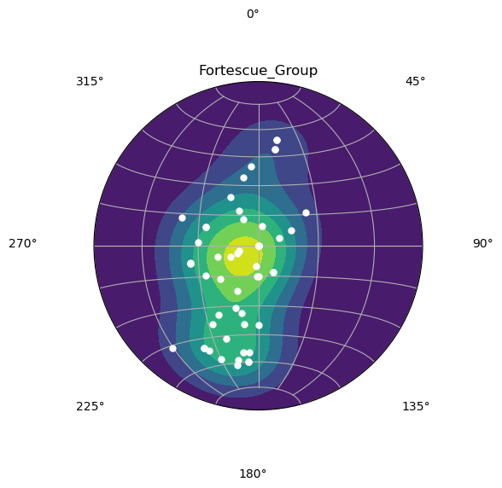
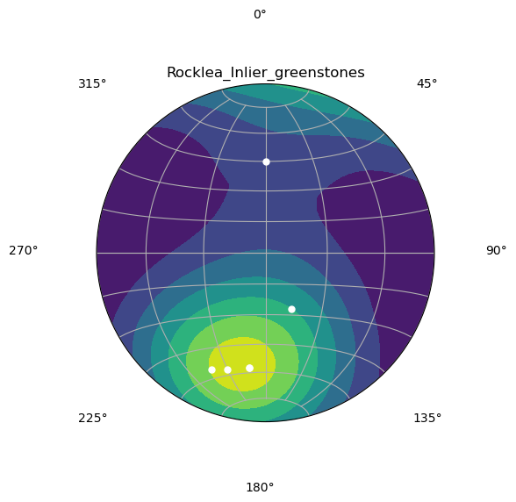
All bedding
Structural domaining, at present
Hamersley Gp
Fortescue Gp
Rocklea Inlier

Slide 24
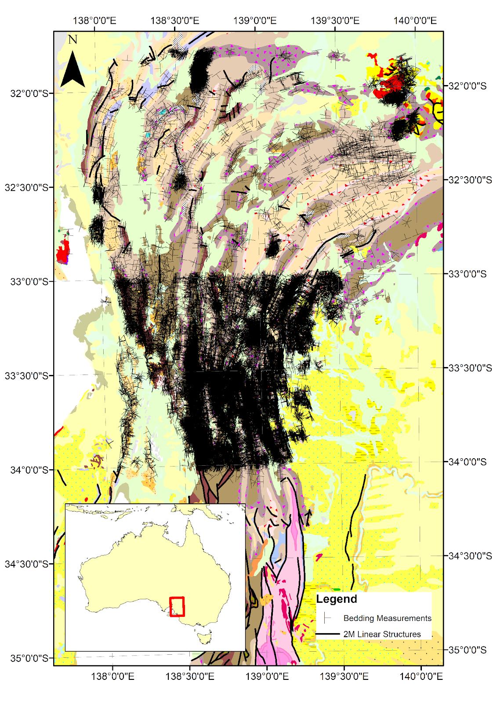
Ranee Joshi
Too much data in some areas:
Slow to calculate
Second-order fold structures
Very variable data density

Slide 25
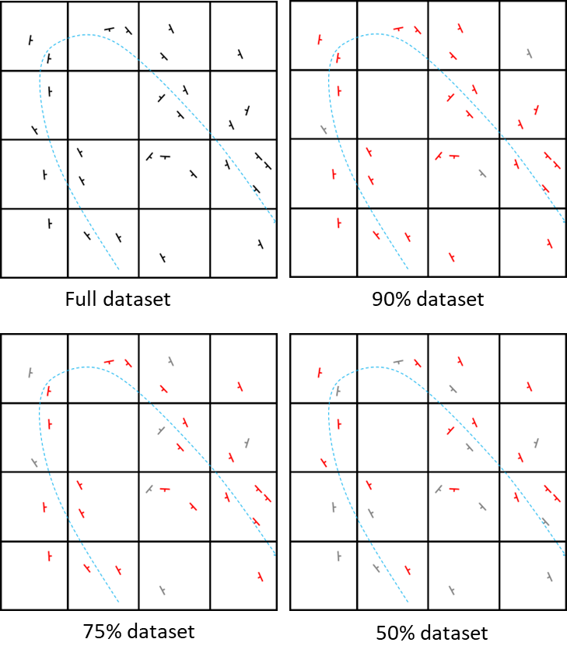
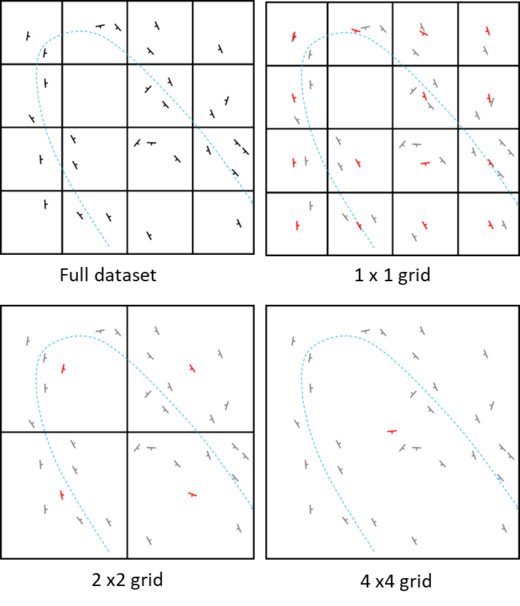
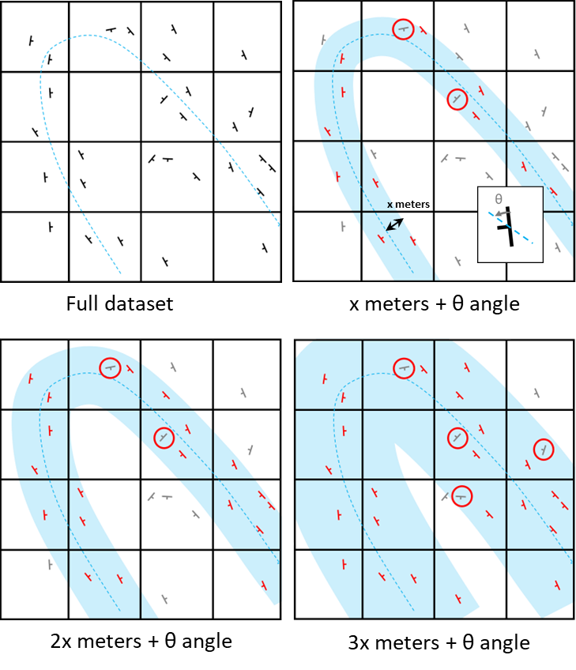
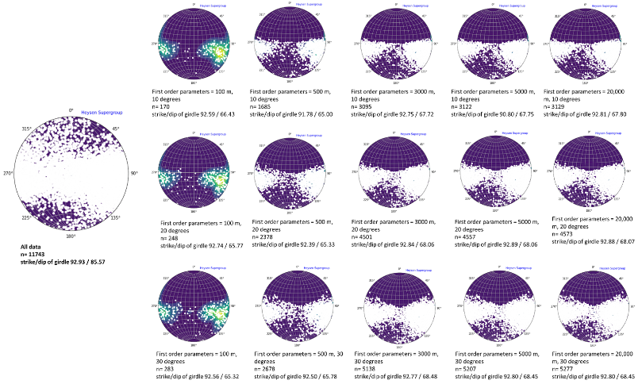
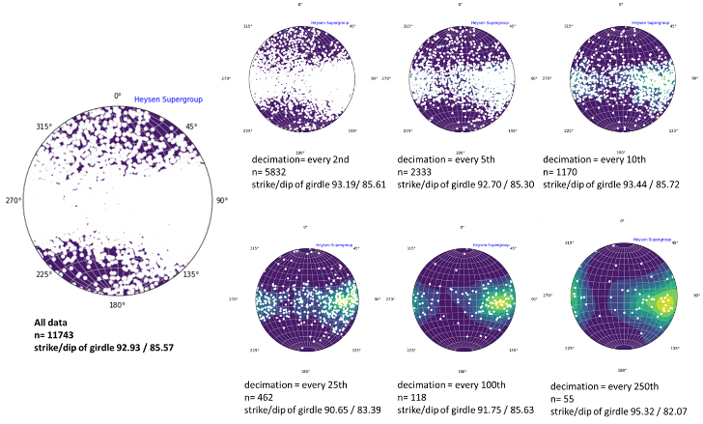
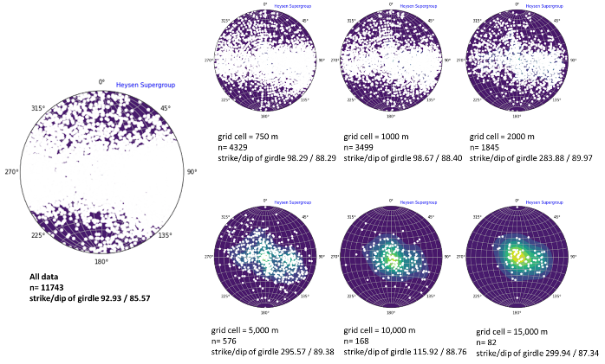
Upscaling of structural data:
Ranee Joshi
Keep X% of observations
Grid Approaches
Contact Aware Approaches

Slide 26
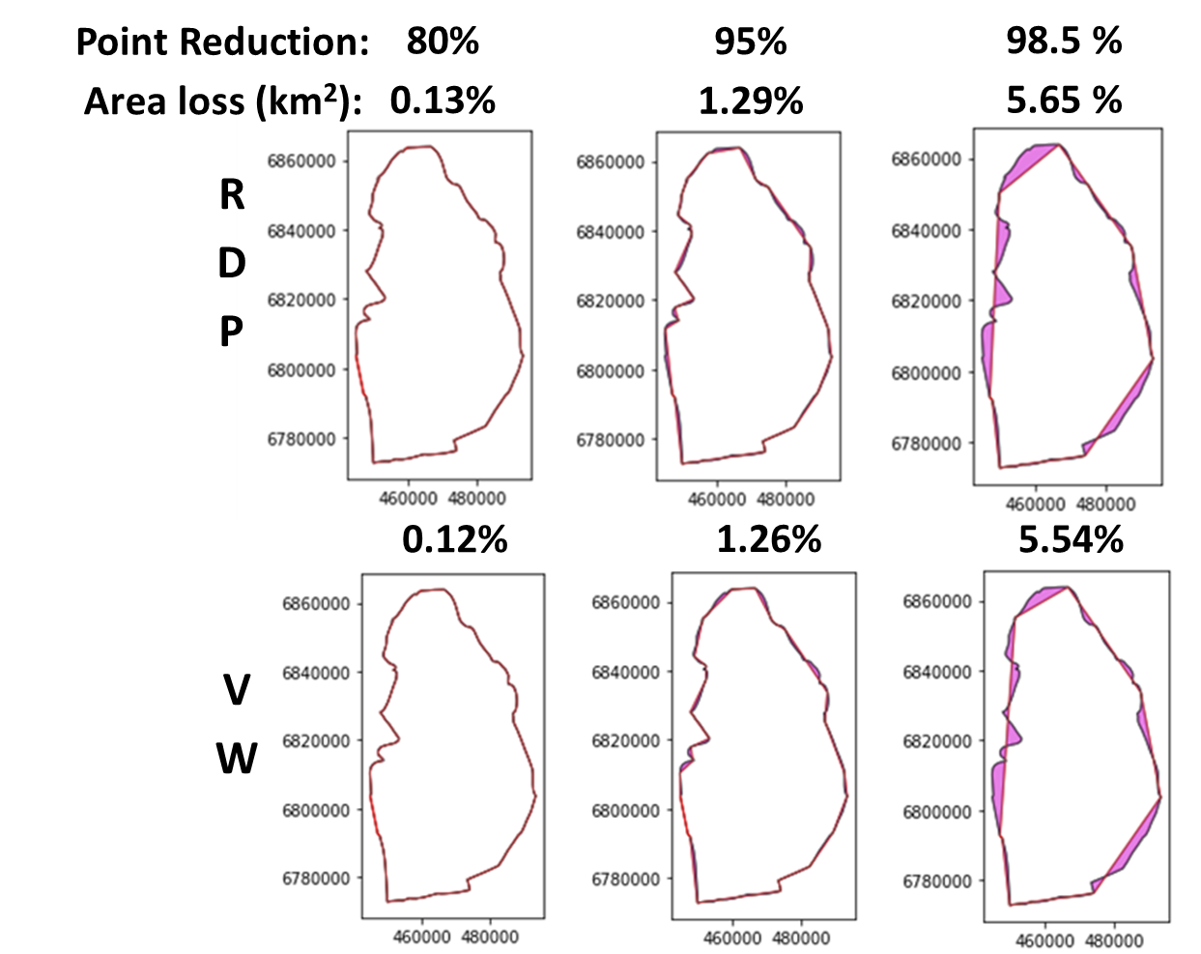
2. Ranee Joshi: Up/down scaling and variable scale models
Method | Description
Decimation on basal contacts (existing map2loop function) | This algorithm simply removes every nth point from the input polylines.
Ramer–Douglas–Peucker algorithm | The Douglas–Peucker algorithm selects the vertices to delete based on minimizing local area changes from node deletion.
Visvalingam–Whyatt algorithm | This method preserves topological relationships to adjacent polygons, preserves proximity to other polygons and preserves shape patterns that are necessary in geological interpretations.
Modified Visvalignam-Wyatt | This newly-developed code lists the shared borders and critical shared points to be preserved prior to applying the Visvalignman-Whyatt simplification, to ensure that triple points and shared polygon contacts are preserved.

Slide 27
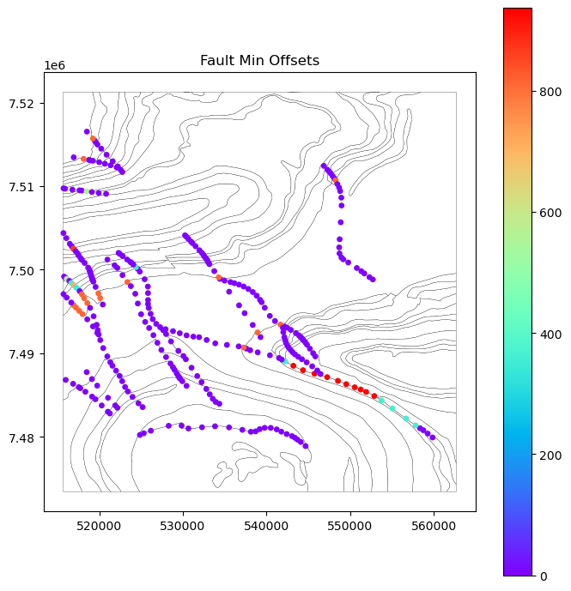
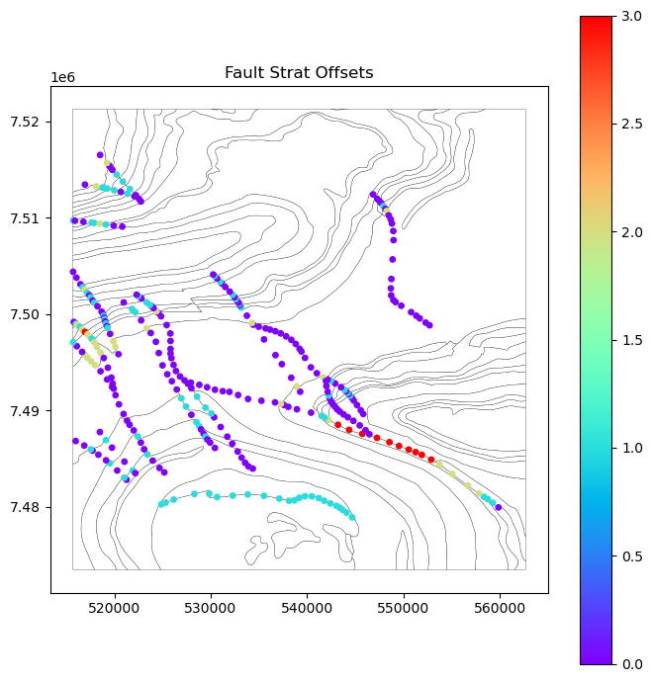
Fault Offsets at present

Slide 28
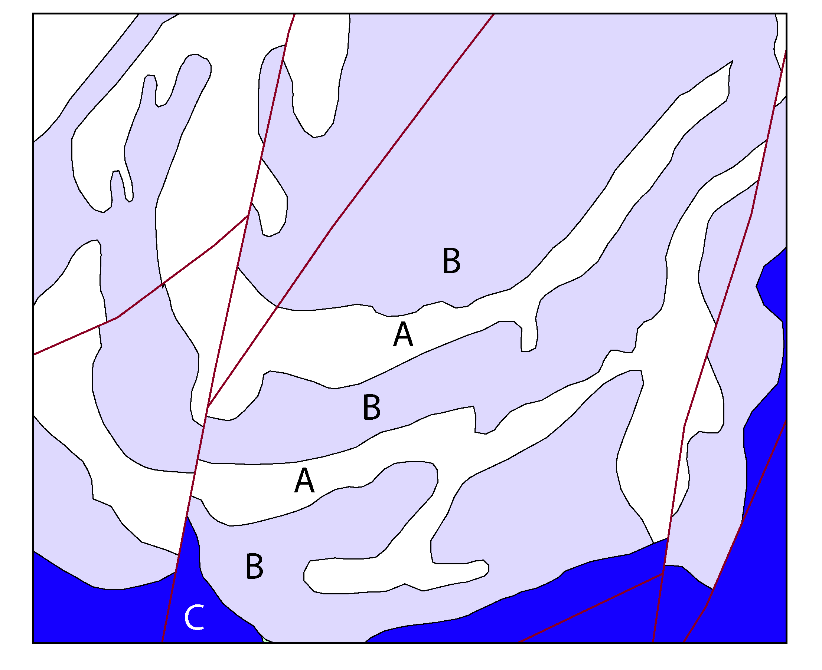
More map analysis to overcome, or at least highlight map ‘quirks’:
Fault topology
No offsets, possible but unlikely
Incoherent ages
Does the C-B-A-B-A-B sequence simply reflect lithology, or is it folded and or faulted stratigraphy?
Recoding formations, e.g. when a polygon is labelled as a Group

Slide 29
Stratigraphy and Fault Age relationships, at present:
One of many possible age sortings is chosen for both faults and stratigraphy
No use of Faults vs Folds vs Stratigraphy to further refine age relationships
f
Fold axial trace

Slide 30
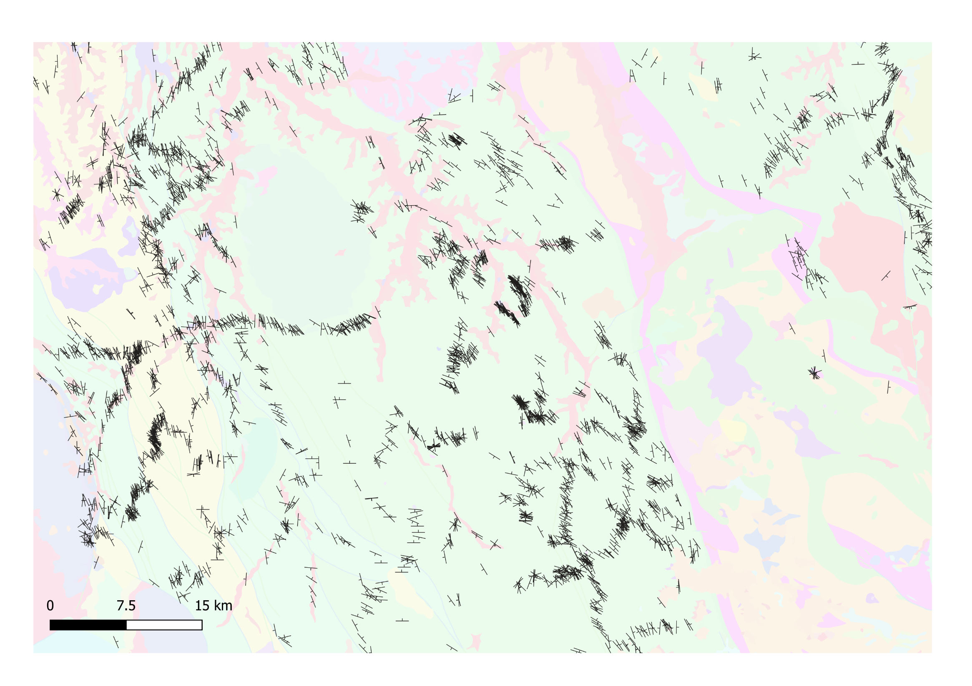

Bedding
What we currently use in map2loop

Slide 31
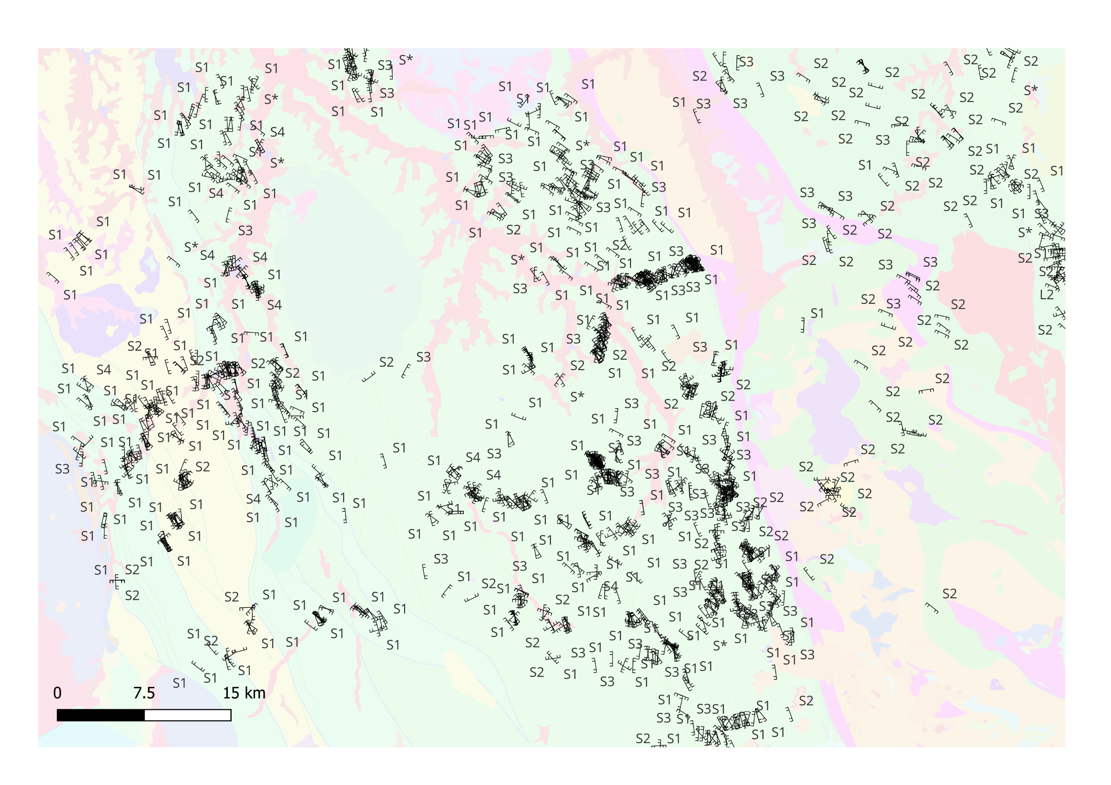
Cleavages

Slide 32
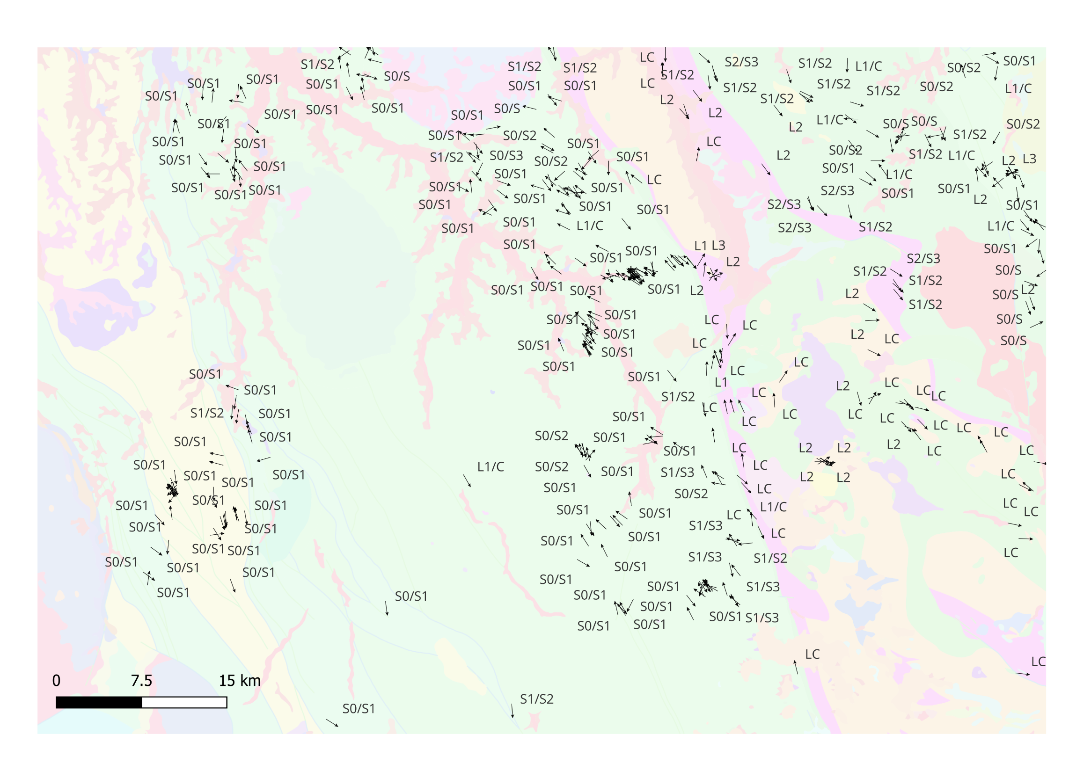
Intersection Lineations
Local vergence calculations will feed into LoopStructural’s age-aware calculations

Slide 33
map2loop automation :
Significantly reduces the time to first prototype models;
Allows reproducible modelling from raw data, whereas current Uncertainty Quantification workflows start from model-ready inputs;
Clearly separates the primary observations, interpretations, derived data and conceptual priors during the data reduction steps; and
Provides a homogenous pathway to Sensitivity Analysis, Uncertainty Quantification, Multiscale Modelling and Value of Information studies.

Slide 34


Proof of concept, use at your own risk!

